Slide 1
01
The Battle of Neighbourhoods (Week 2)
Coursera - Applied Data Science Capstone
The Battle of Neighbourhoods
A project by
Henrique Sarmento
October, 30
2020

Slide 2
02
Introduction
The Battle of Neighbourhoods
A project by
Henrique Sarmento
October, 30
2020

Slide 3
03
Background
Moving around cities can be quite troublesome, mostly when we do not know if the new neighbourhood have everything we indeed want. To make our lifes easier, we'll try to sort this out. We'll be using the Foursquare API to propose the most suitable neighbourhood to move considering we are moving around Toronto, Canada.
For this challenge, we'll exploring a random neighbourhood in Canada, select some venues we deem most important and, with the help of an recommendation system, we'll choose the most suitable place to move.
The Battle of Neighbourhoods
A project by
Henrique Sarmento
October, 30
2020

Slide 4
04
The Problem
Objective
Move to a new place takes time and there's way too much info to evaluate. Without the proper tools and information we can be overwhelmed by what's presented to us and get lost in track about what really matters.
Using the Foursquare API will analyse the Venues nearby all available neighbourhoods in Toronto and grade some of those according to our own preferences. Once this is done, we'll apply a recommendation system technique to calculate the most suitable place to move in.
The Battle of Neighbourhoods
A project by
Henrique Sarmento
October, 30
2020

Slide 5
05
Data
Methods
https://en.wikipedia.org/wiki/List_of_postal_codes_of_Canada:_M
Data cleaning
Foursquare API
Recommendation System
The Battle of Neighbourhoods
A project by
Henrique Sarmento
October, 30
2020

Slide 6
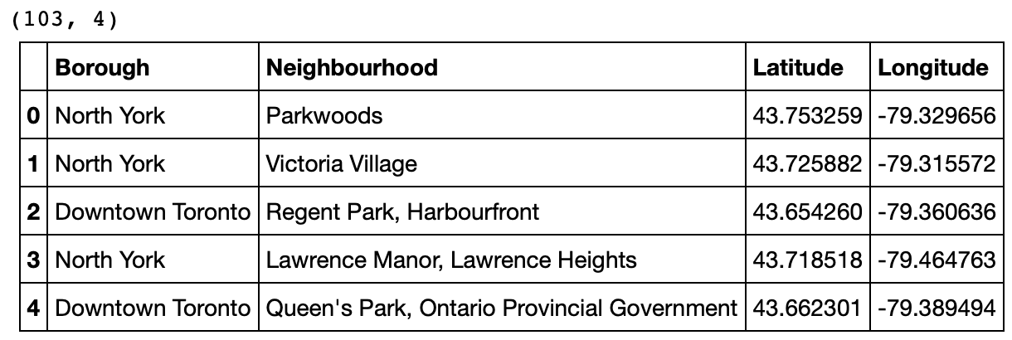
06
Data cleaning
The Battle of Neighbourhoods
A project by
Henrique Sarmento
October, 30
2020

Slide 7
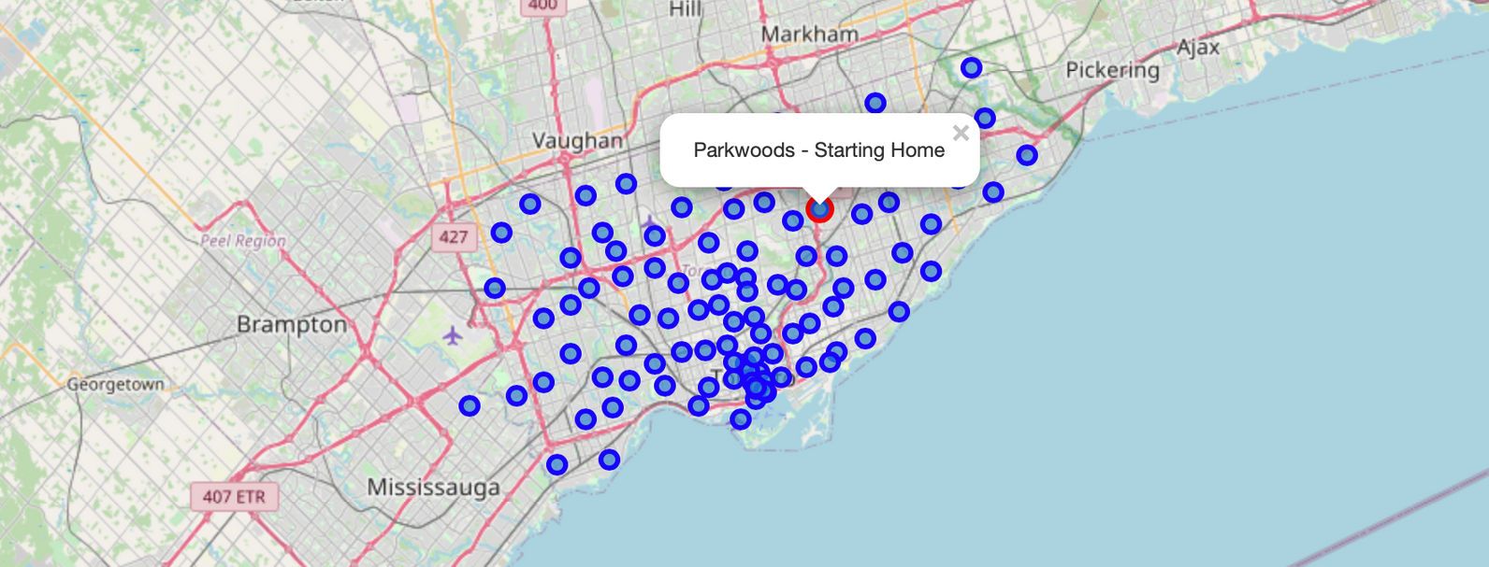
07
Starting point
The Battle of Neighbourhoods
A project by
Henrique Sarmento
October, 30
2020

Slide 8

08
Foursquare API
Exploring venues made easy
The Battle of Neighbourhoods
A project by
Henrique Sarmento
October, 30
2020

Slide 9
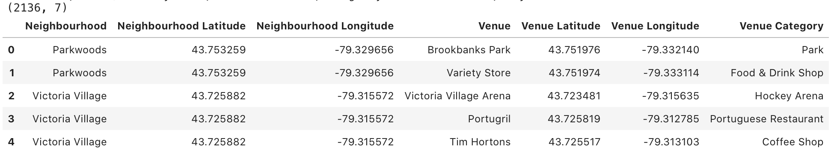
09
Data wrangling
The Battle of Neighbourhoods
A project by
Henrique Sarmento
October, 30
2020

Slide 10
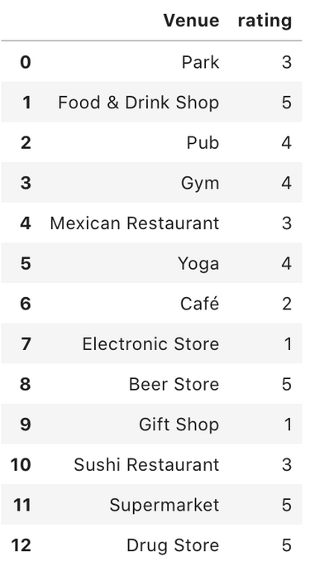
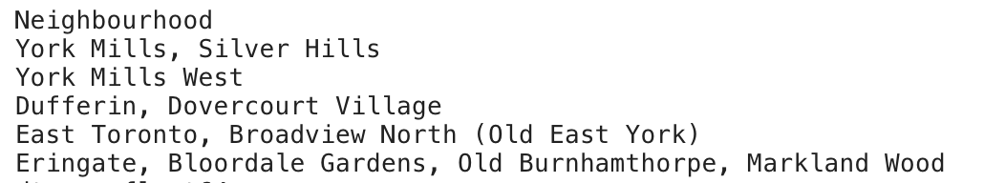
10
Recommendation system
What really matters to you?
Where are we going?
The Battle of Neighbourhoods
A project by
Henrique Sarmento
October, 30
2020

Slide 11
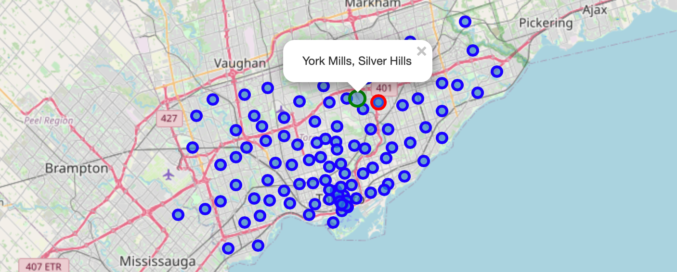
11
Our new home
The Battle of Neighbourhoods
A project by
Henrique Sarmento
October, 30
2020

Slide 12
12
Conclusion
The Battle of Neighbourhoods
A project by
Henrique Sarmento
October, 30
2020

Slide 13
13
Project highlights
Significant discovery
MOVING MADE EASY
THERE IS A BETTER WAY
Recommendation system are powerful tools to help make better decisions.
The new place suits our needs and has everything we asked for, but we would need more input from the user to find the actual best place.
The Battle of Neighbourhoods
A project by
Henrique Sarmento
October, 30
2020

